Slide 1
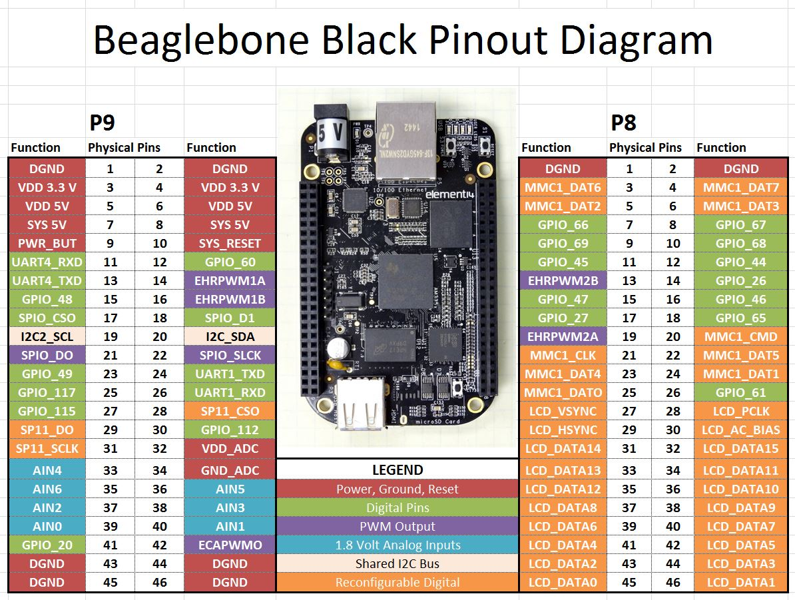
GPIO controller driver

Slide 2
Agenda
Hardware GPIO
Linux user space
Linux kernel space
Demo

Slide 3
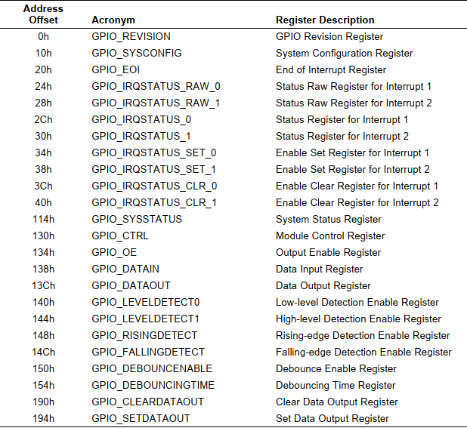
Hardware GPIO
What's GPIO?
Registers of GPIO module in AM3358 SoC.

Slide 4

Linux user space
Idea
To abstract hardware, user can disregard how hardware actually be controlled
sysfs- controller driver
devfs - protocol driver

Slide 5
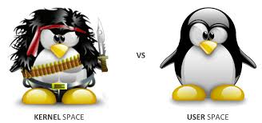
Linux kernel space
Protocol Driver
Controller Driver

Slide 6
Protocol Driver
Idea: Use for any device which is prescient
#include <linux/gpio.h>
character driver

Slide 7
Controller Driver
Idea: To easily control any devices which can be controlled by gpio and is not prescient
implement function pointers that are declare in gpio.h

Slide 8
How to implement Controller Driver?
struct gpio_chip – GPIO controller
struct irq_chip
Kernel API
gpiochip_add_data(): Create sysfs.
gpiochip_irqchip_add(): auto implement gpio_chip.to_irq pointer.
gpiochip_set_chained_irqchip(): Set the parent IRQ for all affected IRQs.
gpiochip_remove()

Slide 9
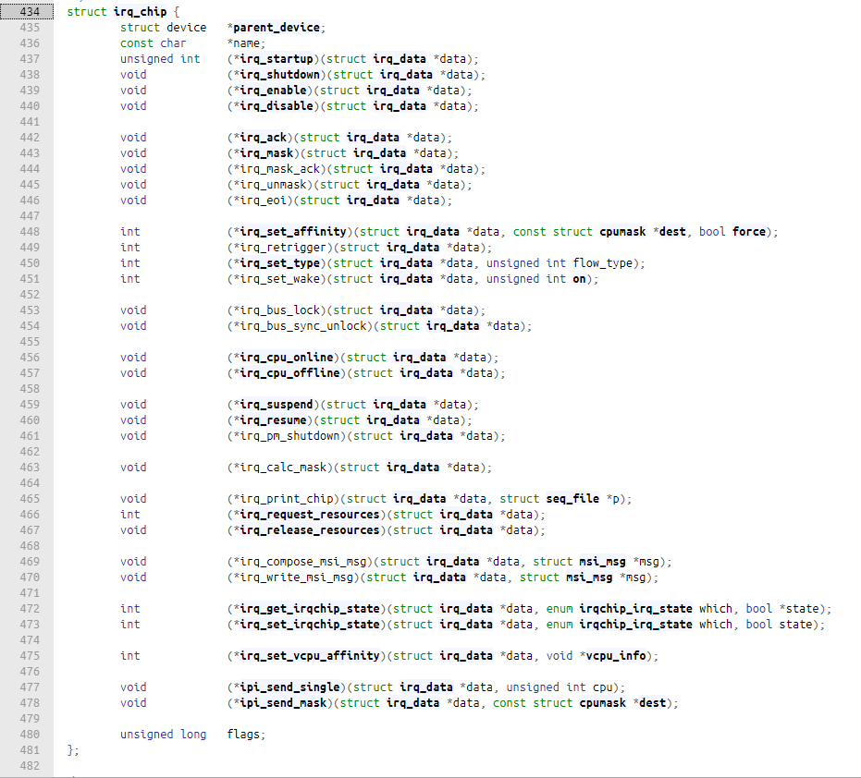
struct gpio_chip

Slide 10
struct irq_chip

Slide 11
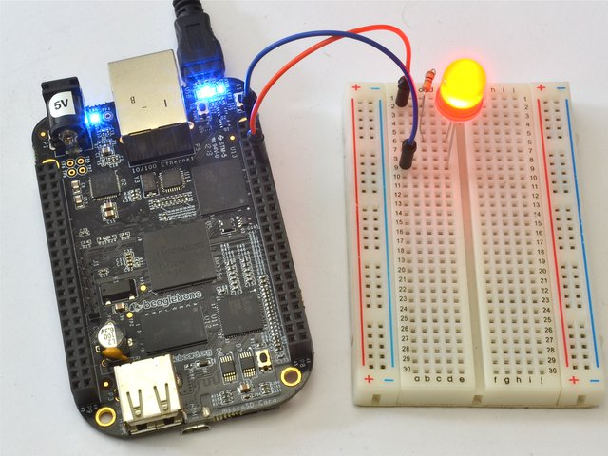
Demo

Slide 12

Summarize
GPIO in Linux kernel:
Protocol driver
Controller driver
Controller driver
struct gpio_chip
struct irq_chip
API to implement:
gpiochip_add_data
gpiochip_irqchip_add
gpiochip_set_chained_irqchip
gpiochip_remove

Slide 13

Thank for watching

